Slide 1


ISTQB Certification Program
Expensify and Payment process

Slide 2


isqui.org
brightest.org
ISTQB exam sponsors

Slide 3
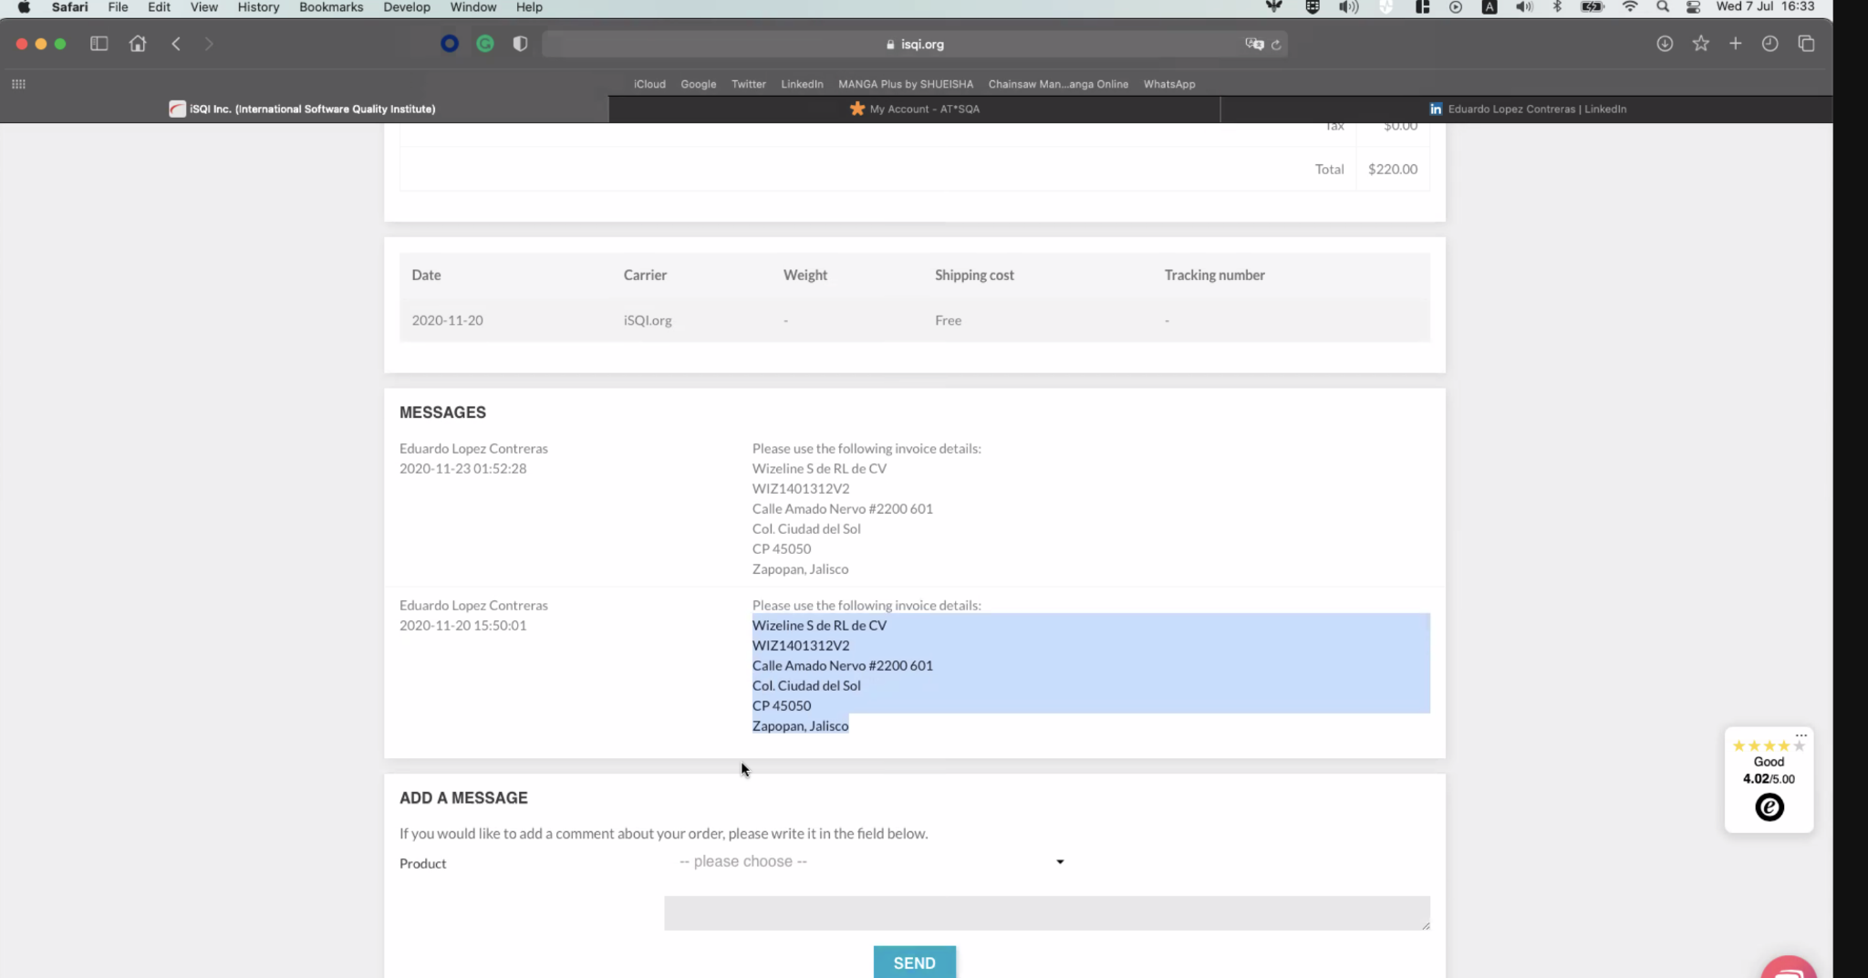
Isqui payment

Slide 4
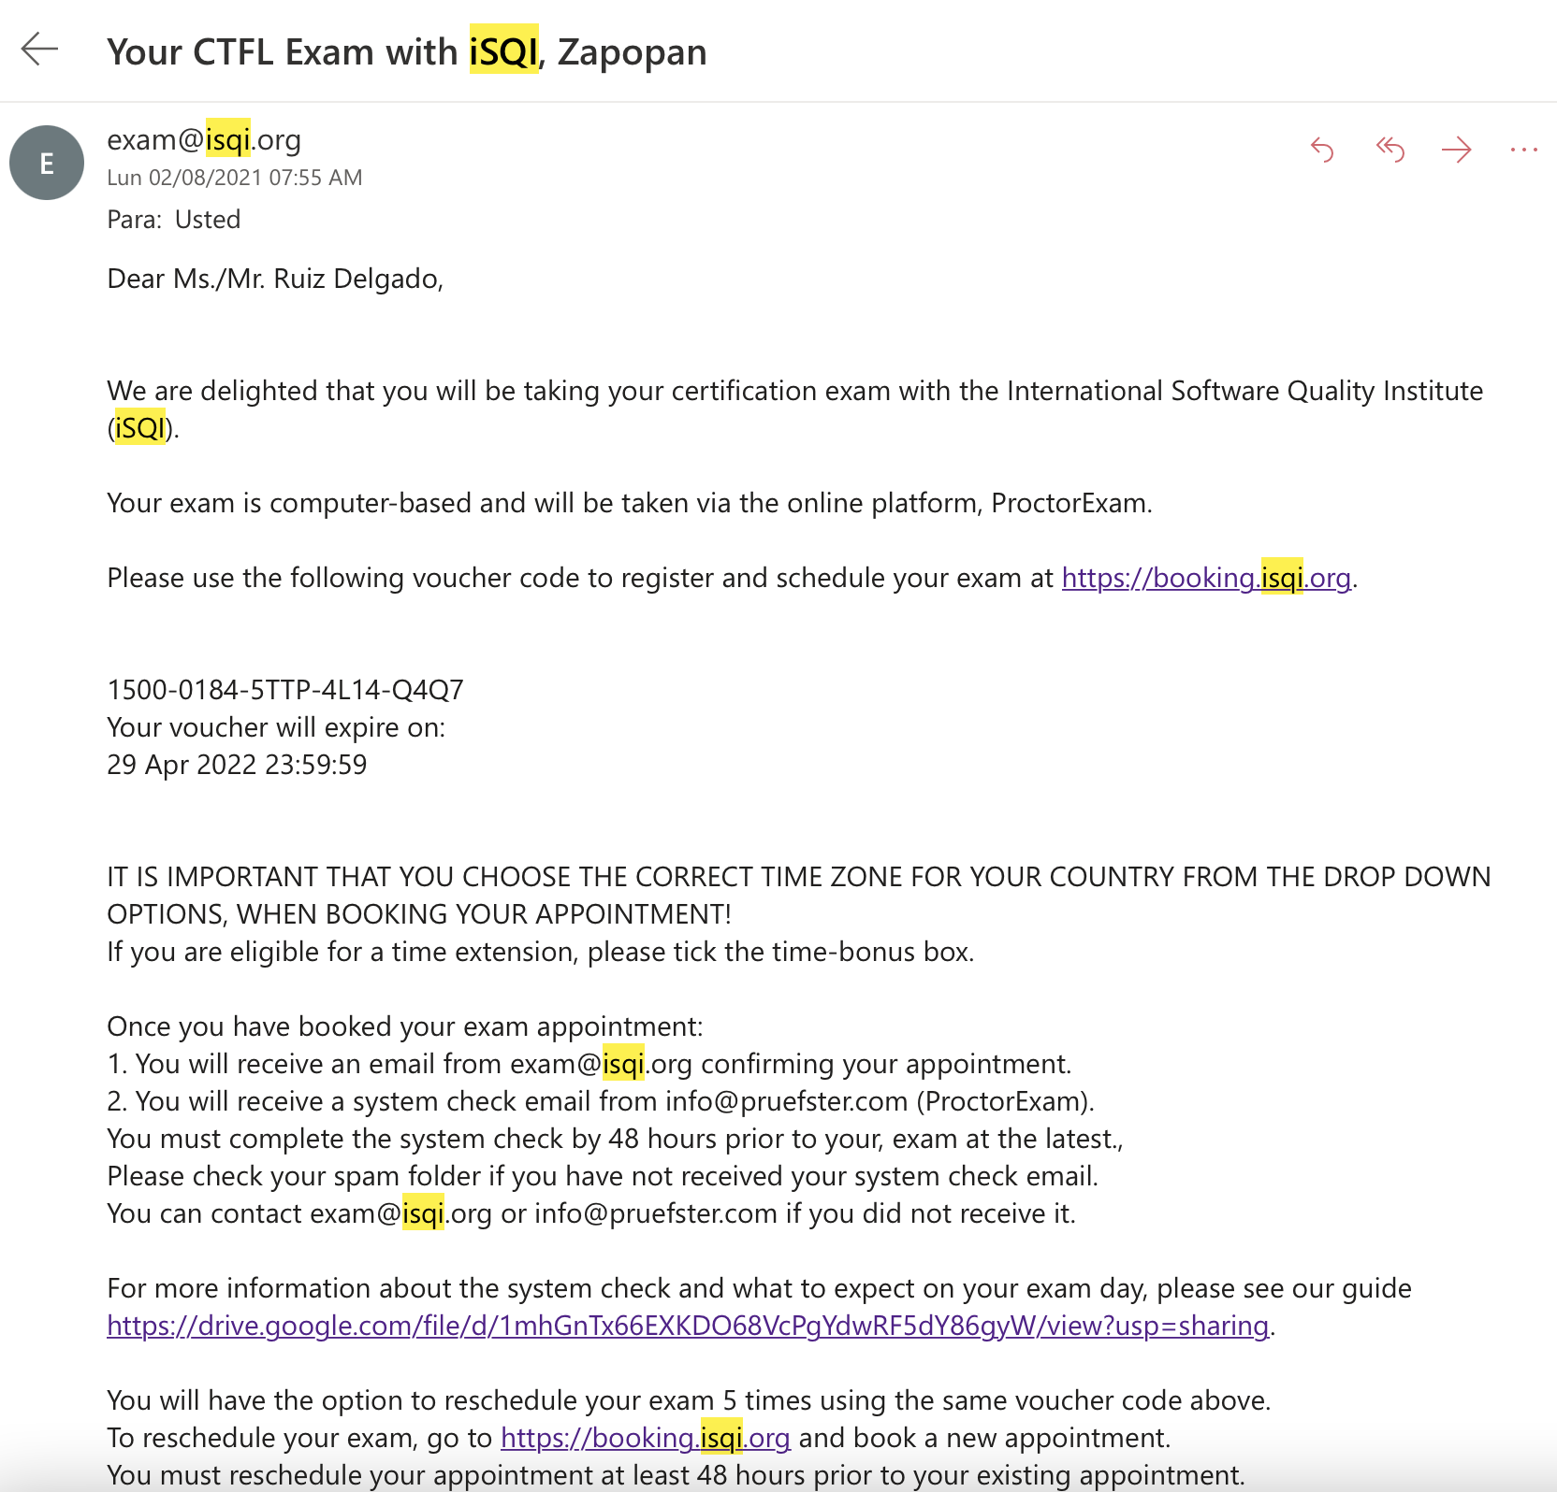

Slide 5
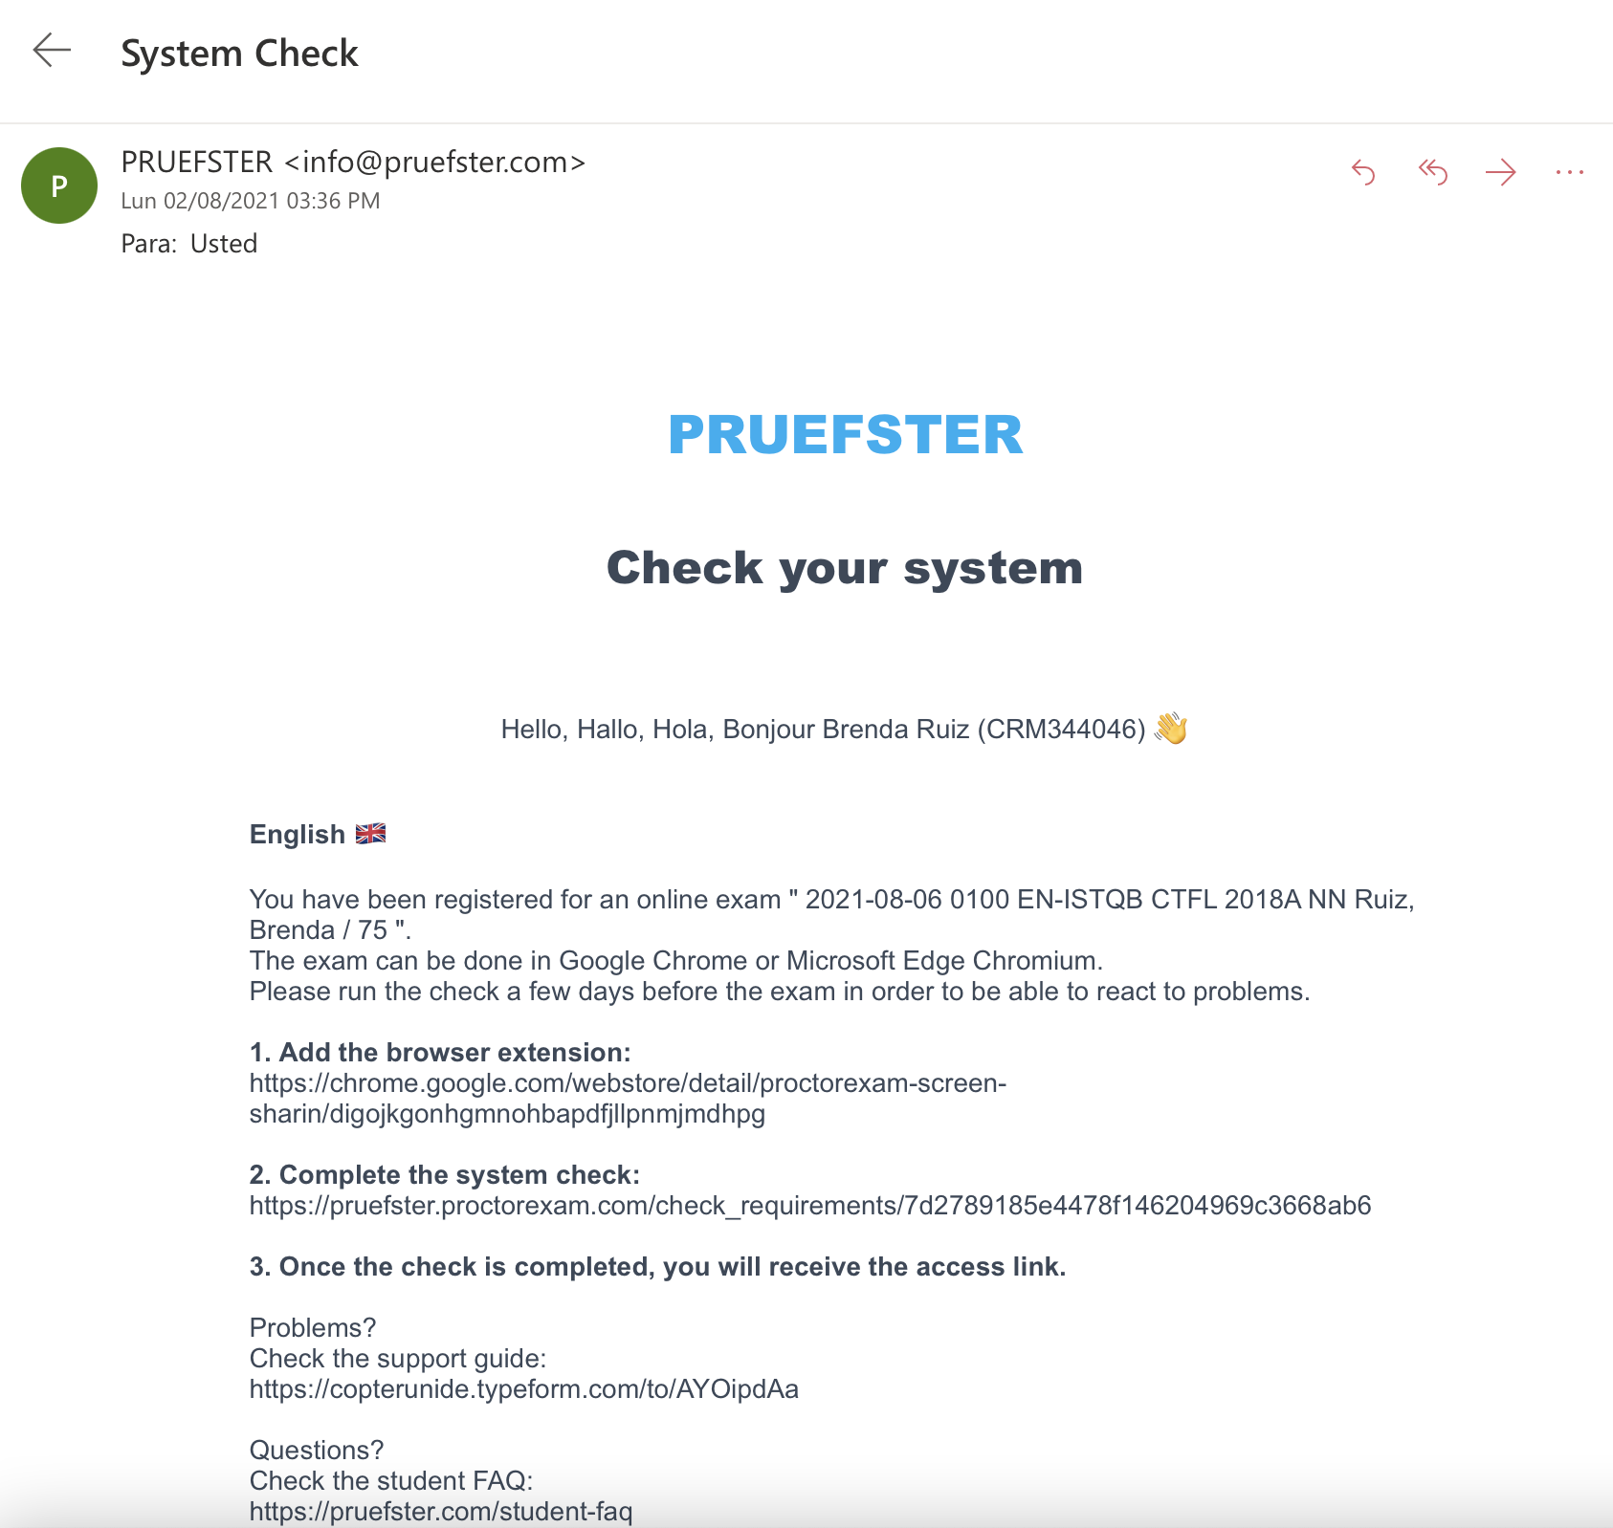
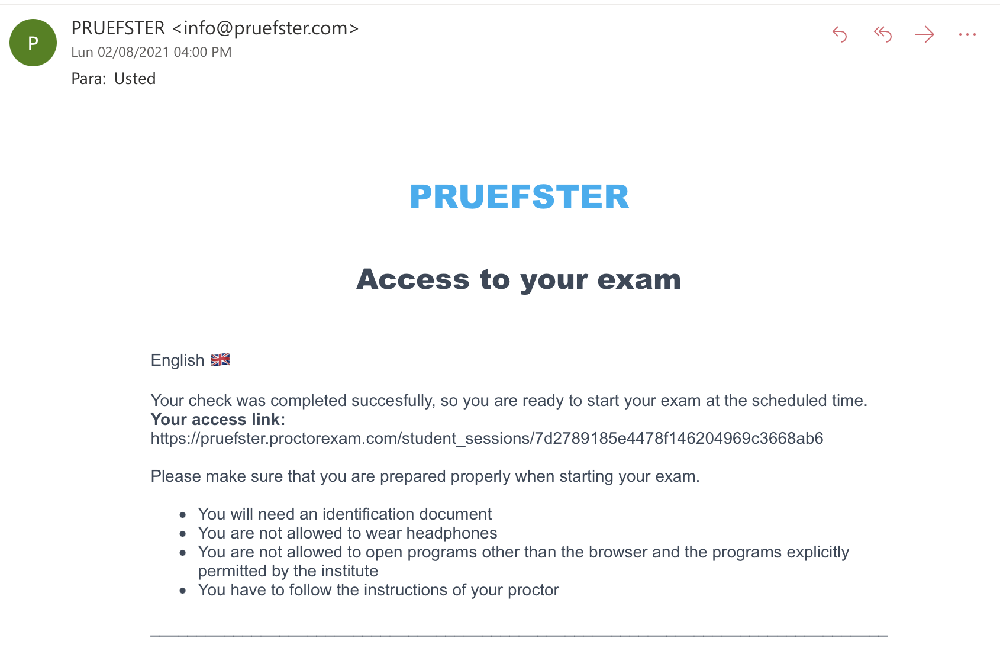
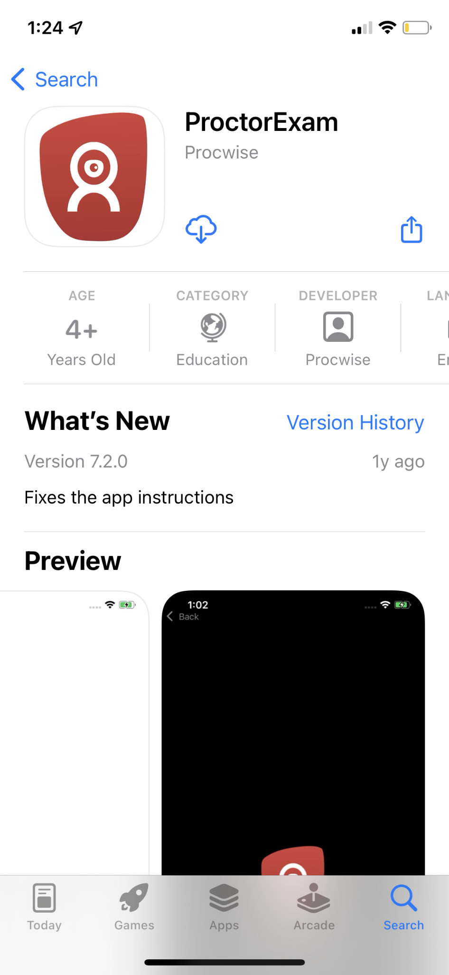

Slide 6
Brightest
payment

Slide 7

At Wizeline, we use an external tool, “Expensify”, for employee’s reimbursements.
Wizeline employees will be reimbursed when they make expenses, on behalf of the company, such as:
Lodging
Airfare
Business meals
Others*

Slide 8
OTHER EXPENSES
For non-business trip related expenses (online training, books, etc.), this is the process you have to follow:
Managers should get approval and budget from Finance (for expenses greater than 500 USD) at approvals.finance@wizeline.com.
Once you get the approval, make sure:
You communicate to your direct reports the budget.
You know the requirements for reimbursement.
Note: Expenses greater than 2k USD must be paid with the corporate credit card.
Notes:
Talk to Vivi and Carol if we will continue with the current practice in VN or if we just add it here.

Slide 9
HOW CAN I GET MY EXPENSIFY ACCOUNT?
Contact your manager if you have to make any type of disbursement related to a business trip you were assigned to (lodging, airfare, business meals, and such). Refer to the Travel and Expense Policy before submitting expenses to ensure you comply with it.
Get approval from your manager to request your Expensify account and once you get it, send it in an email to er@wizeline.com and request your account.
Once ER’s team receives your request (with your manager approval), you will receive the Expensify invitation to join the policy according to your location.

Slide 10
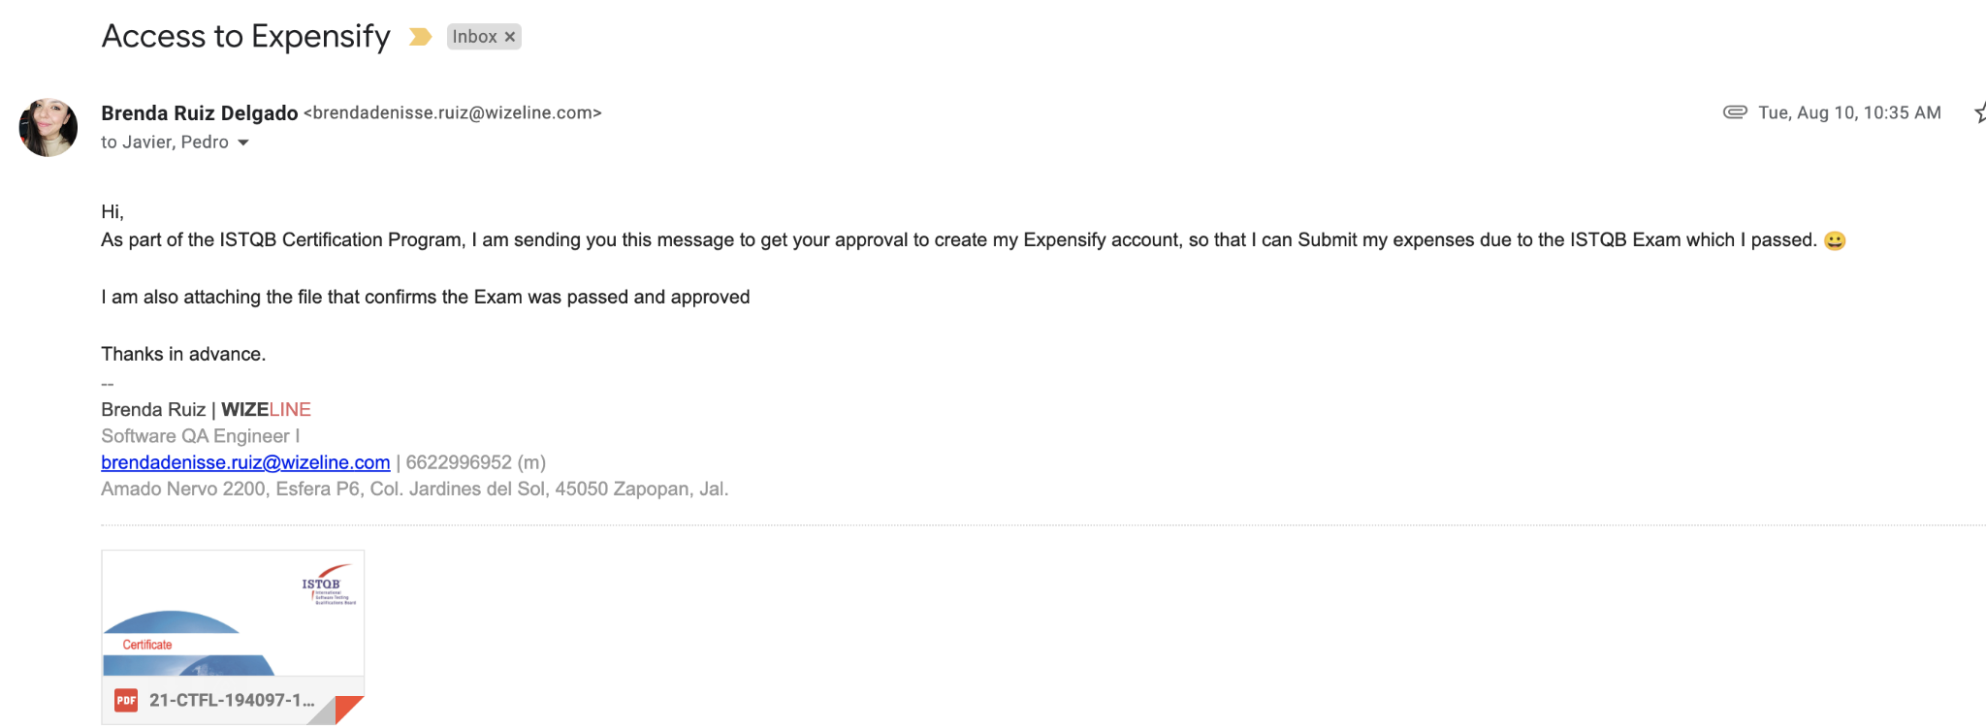

Slide 11

Expensify reports requirements
For any expense made in Mexico (business trip or other), it's imperative for you to upload only valid "Facturas" (only PDF file) to your Expensify Report. In case of a foreign vendor, you can upload a confirmation, ticket or receipt.
If the business trip is outside Mexico, you must upload both into Expensify, receipts and facturas ('facturas' for those expenses made in Mexico).
Here’s Wizeline Mexico fiscal information for your reference when you need to request an invoice,
Wizeline S de RL de CV
WIZ1401312V2
Calle Amado Nervo #2200 Int. 401, 501 y 601
Col. Ciudad del Sol
CP 45050
Zapopan, Jalisco
Make sure you select “Uso de CFDI: Gastos en general”.

Slide 12
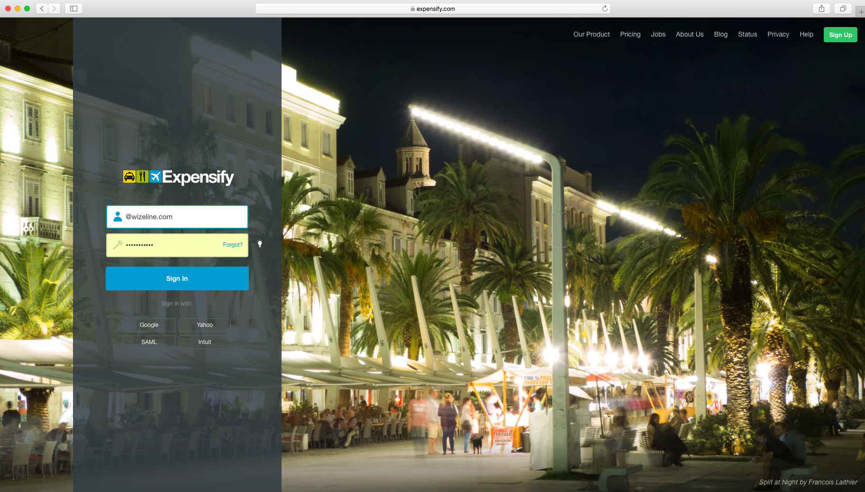
Login into Expensify.

Slide 13
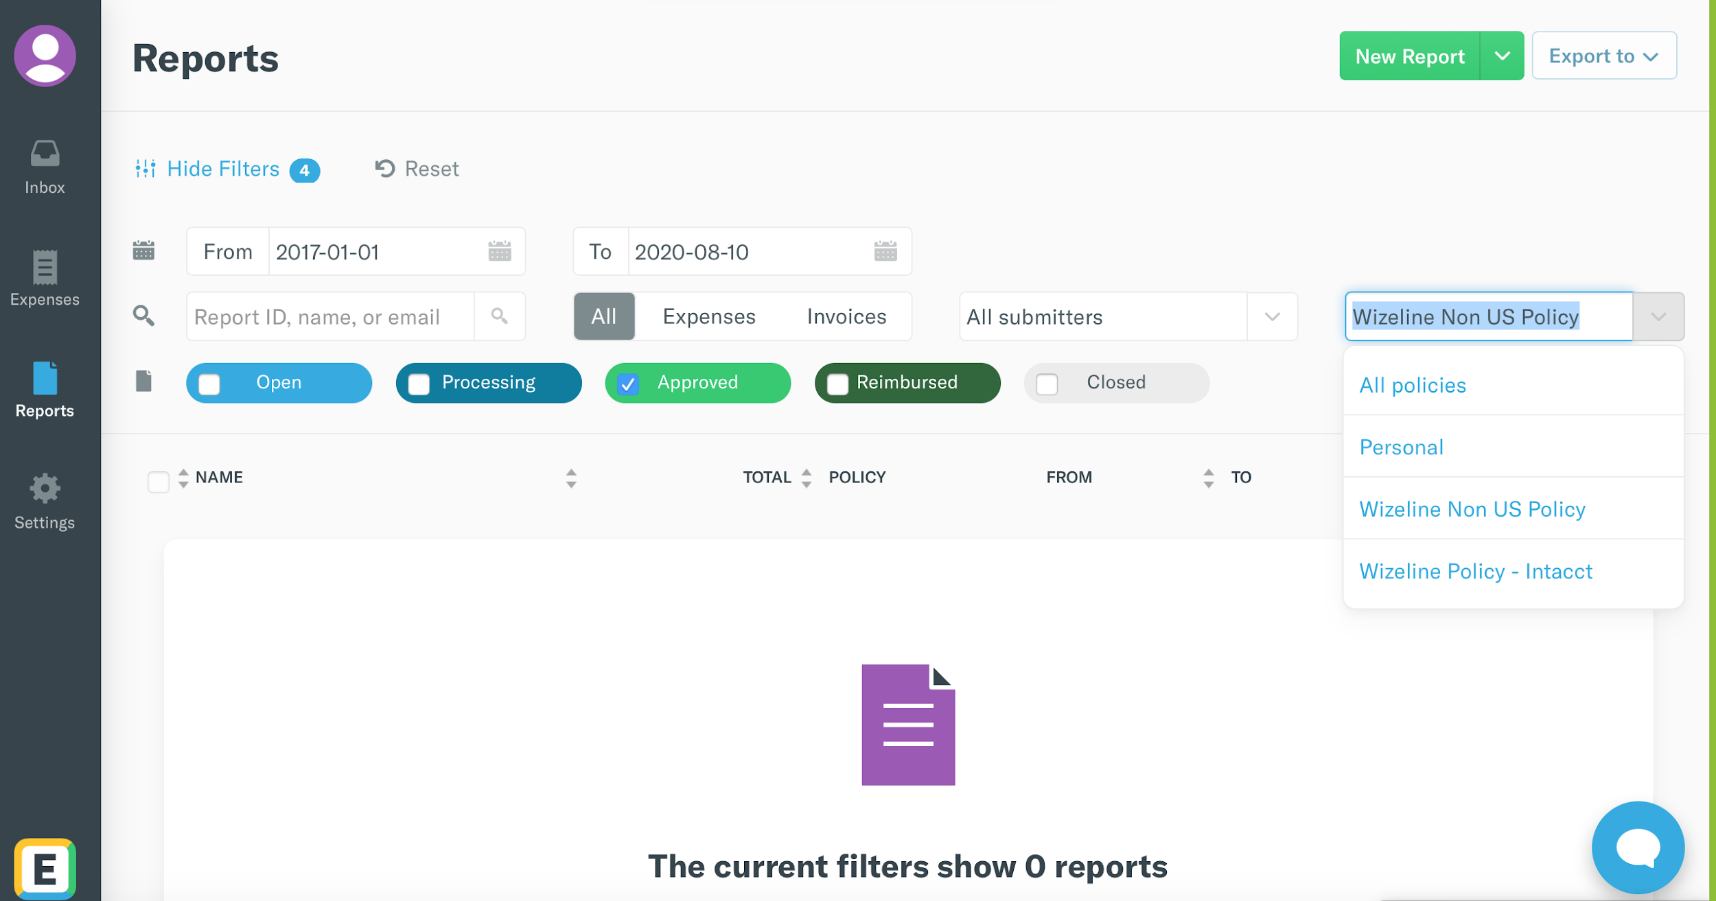
On the left menu, select Reports. Then, click New Report on the top right.
*Make sure you’re using the correct policy according to the office you’re based.

Slide 14
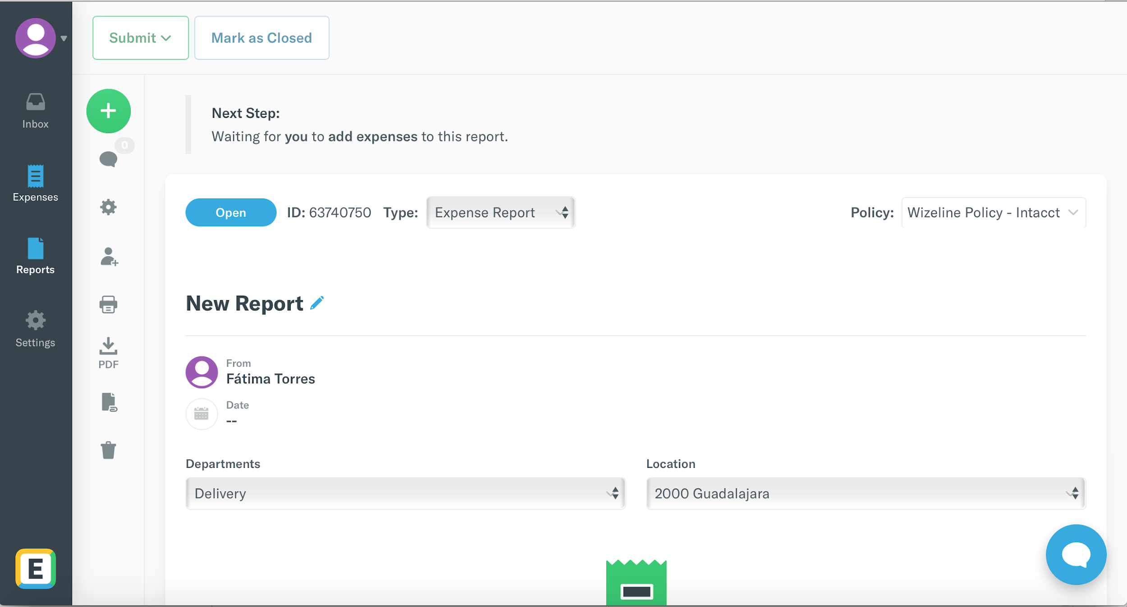
When a new report is created, its status will always be “Open” and it remains until you add your expenses (receipts and invoices) and submit it. You can follow up on your report status using its ID number.

Slide 15
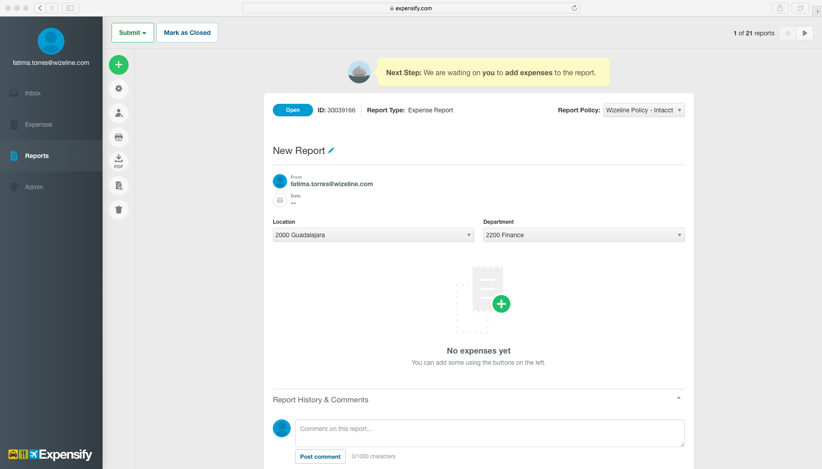
Give your report a title. Make sure you specify the project or the expense in the title. For example: “Health benefit (month)”, “Disney’s onsite”, etc.
Note: If your expenses are billable to the customer, mention it in the title of your report.

Slide 16
Select your Location. This refers to the Office where you are based / hired:
1000 San Francisco
2000 Guadalajara
2010 CDMX
2020 Querétaro
3000 Ho Chi Minh
4000 Sydney
5000 Thailand

Slide 17
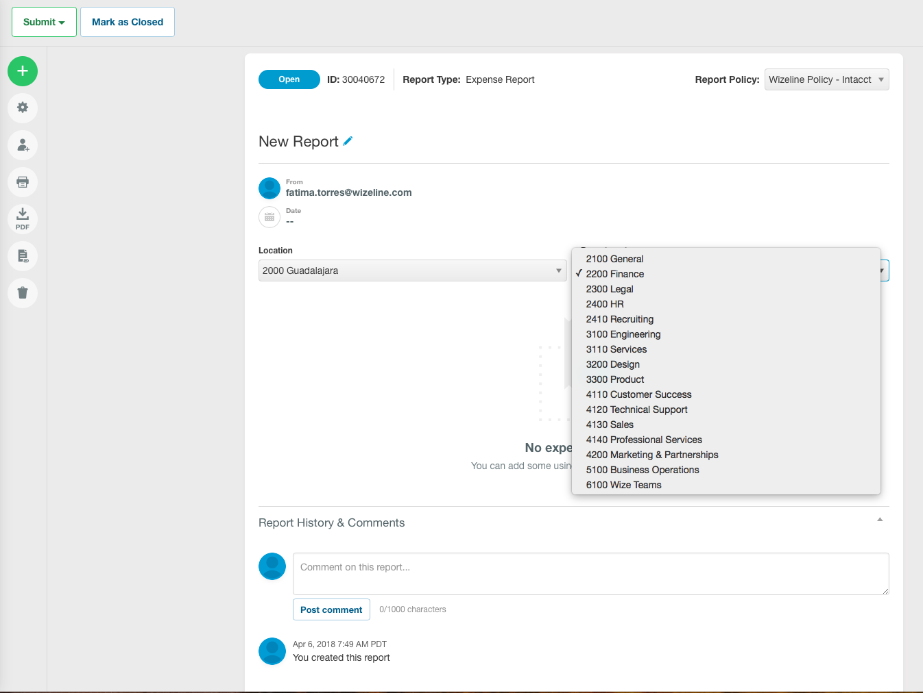
Select your Department. Even if you are submitting an expense or a trip for a different department, you must select the one you belong to in the first “Department” field (e.g., UX team making a workshop trip must select UX as department, not Engineering or Sales.)

Slide 18
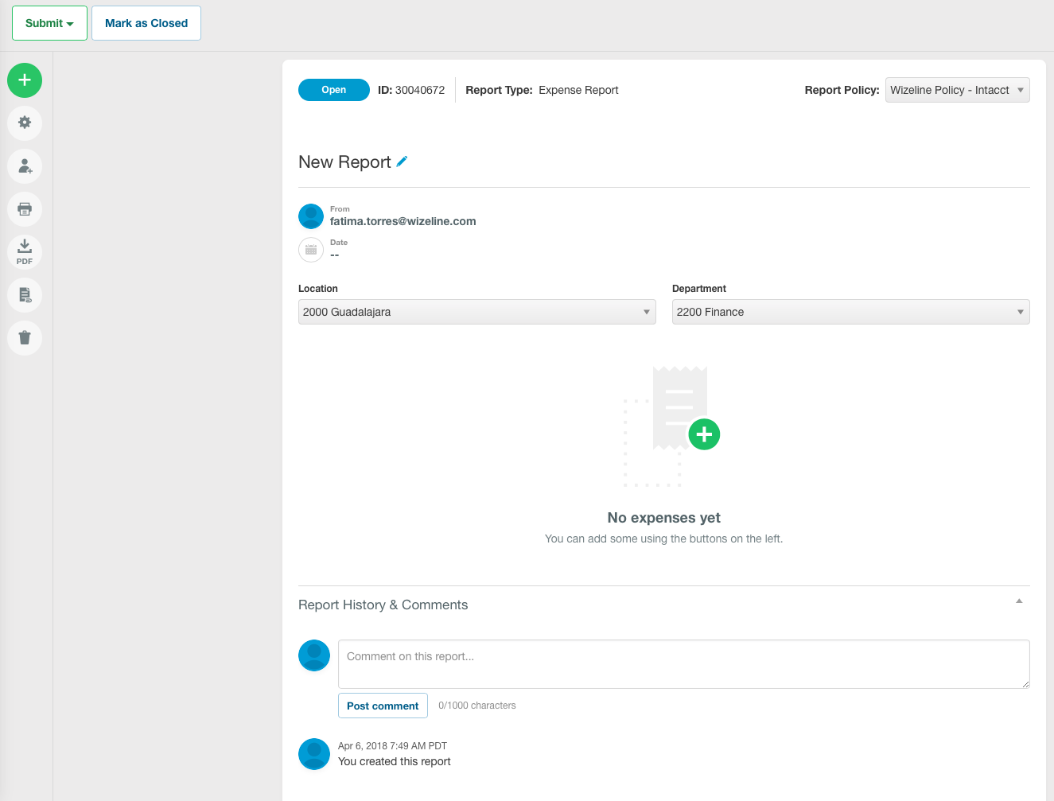
Click the + sign to start adding your expenses (invoices and receipts). You must add the expenses one by one.

Slide 19
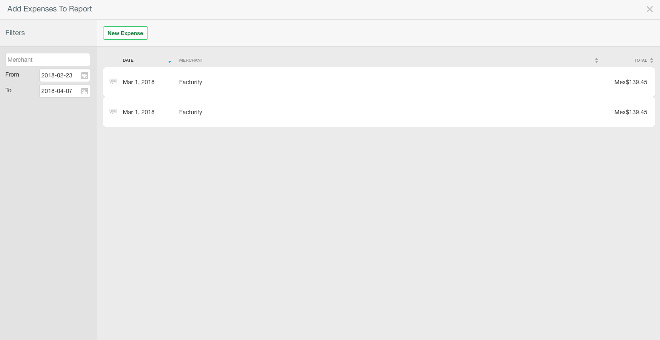
Click New Expense to add an expense.

Slide 20
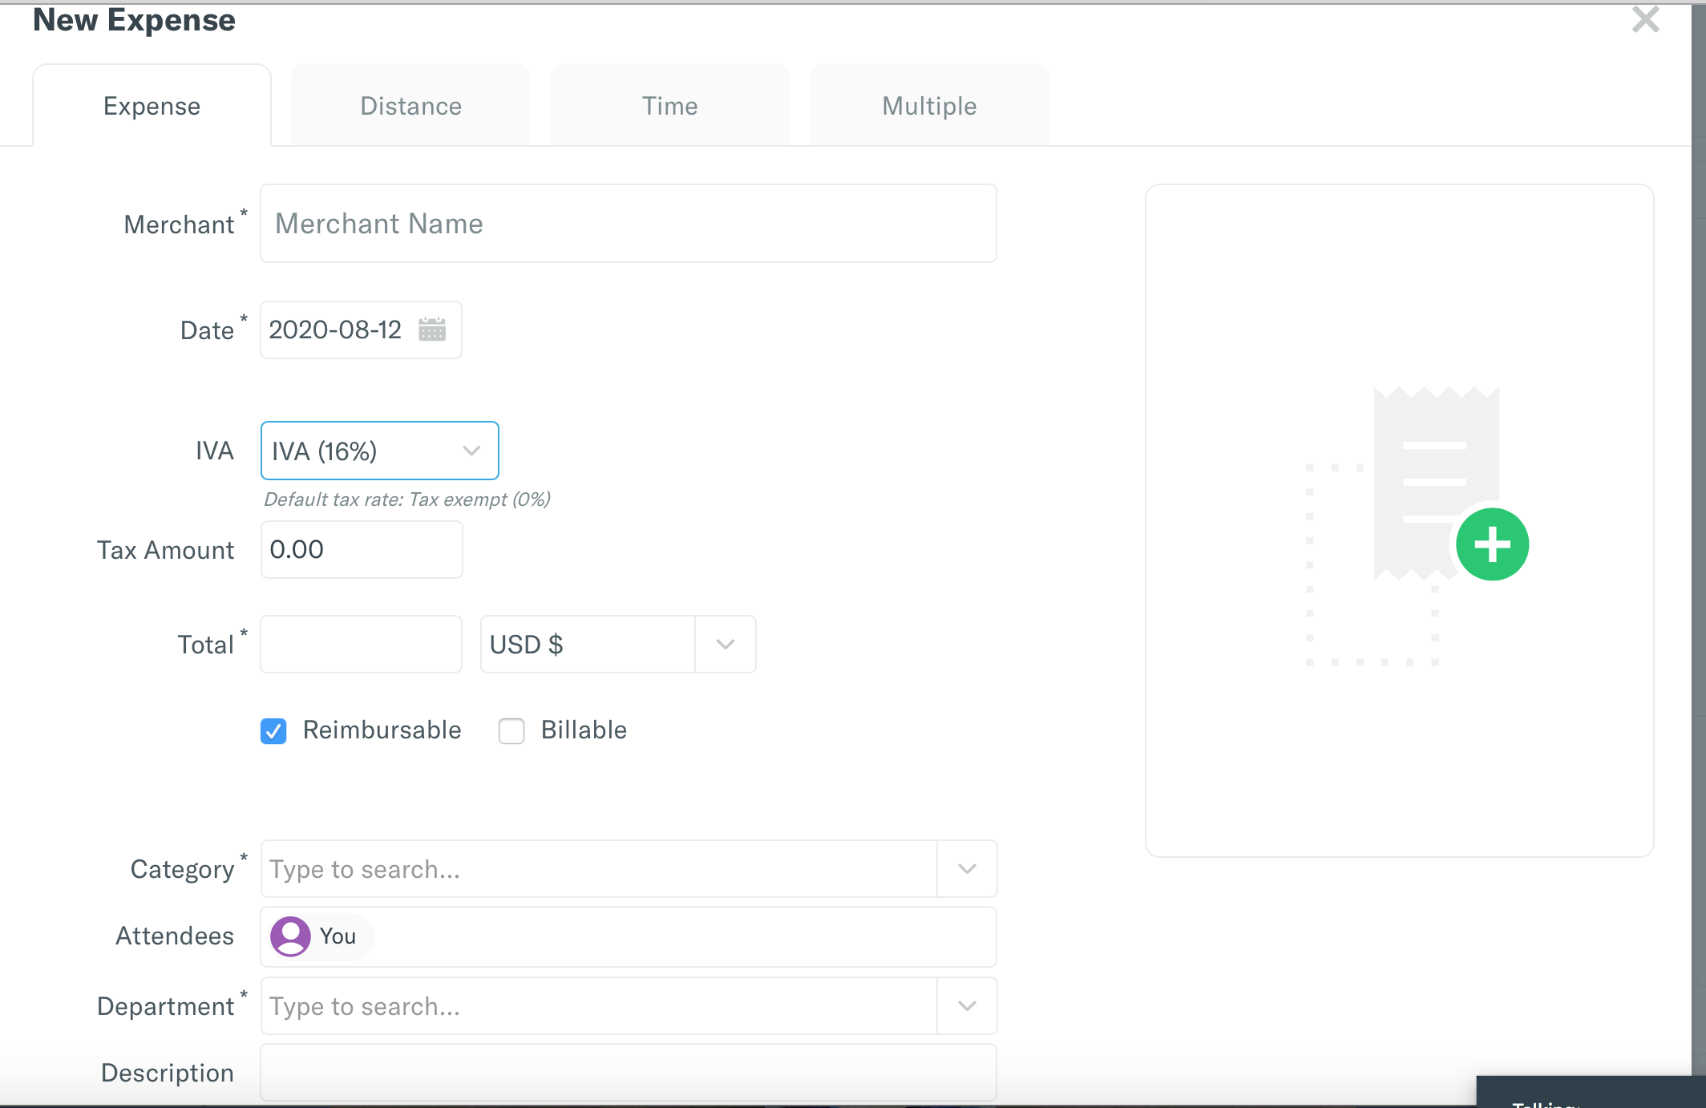
Fill in the information about the expense you’re submitting, such as Merchant, Invoice date, Tax rate and Tax amount (only for MX), Total amount (choose the right currency and the exact amount reflected on your bank statement), and Category (airfare, business/travel meals, etc.). Finally, select again the Department you belong to or the Department which the expense is related to.

Slide 21
Upload supporting files such as invoice or receipt by clicking the + sign. Be aware that any missing information may cause a reimbursement delay or rejection.
Note: MX employees, make sure you upload the PDF file.

Slide 22
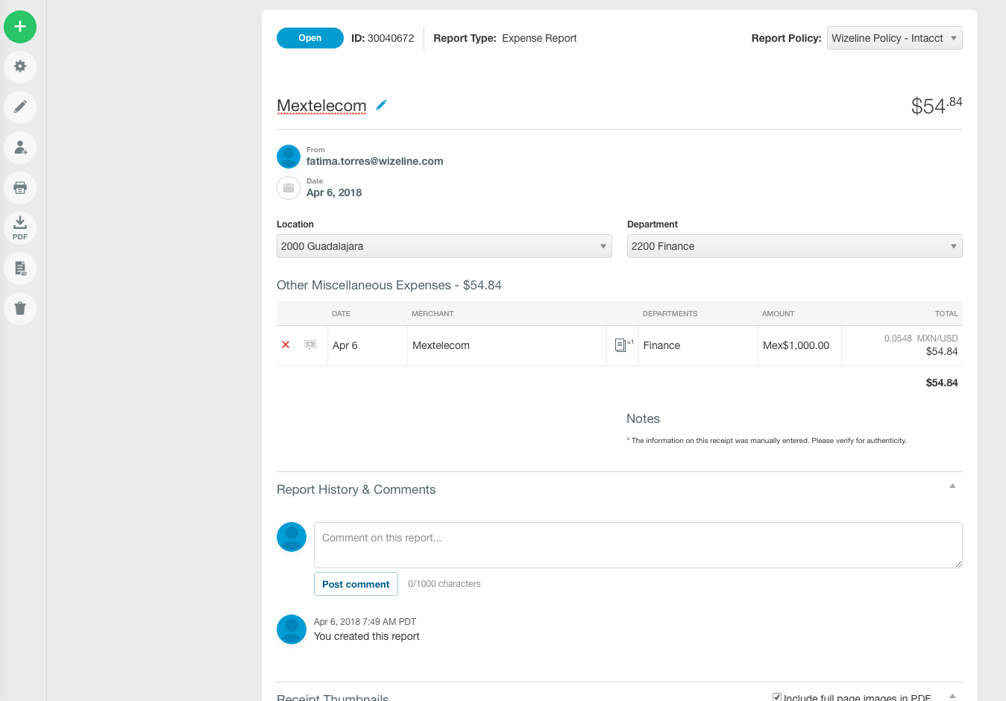
Review your report before submitting it to your manager. Verify all the information you are reporting. Make sure there aren’t any duplicate expenses and that you have uploaded all the supporting files. Be aware that any missing information may cause a reimbursement delay or rejection.

Slide 23
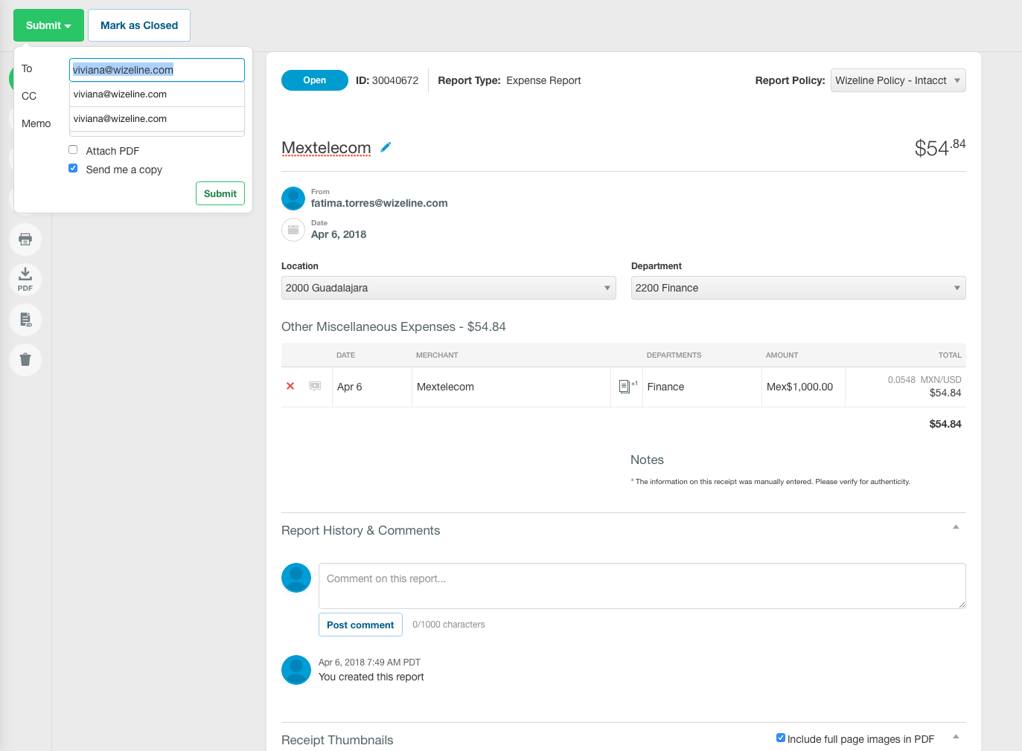
When your report is completed, click Submit to send it to your manager for final approval.

Slide 24
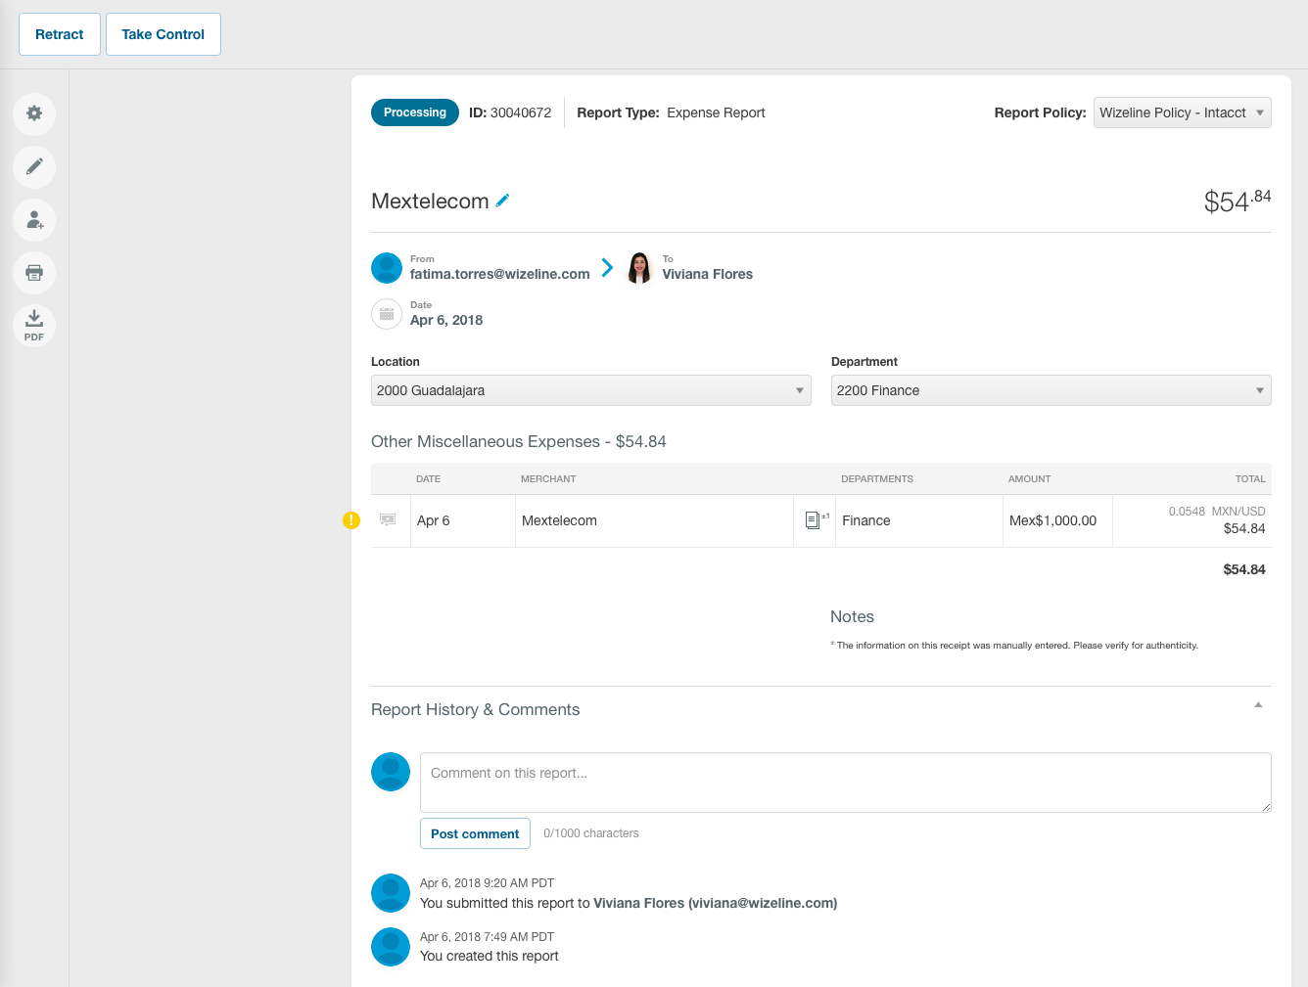
When you submit your report to your manager, your report status changes to Processing. Managers receive an email requesting to approve the reimbursement.

Slide 25
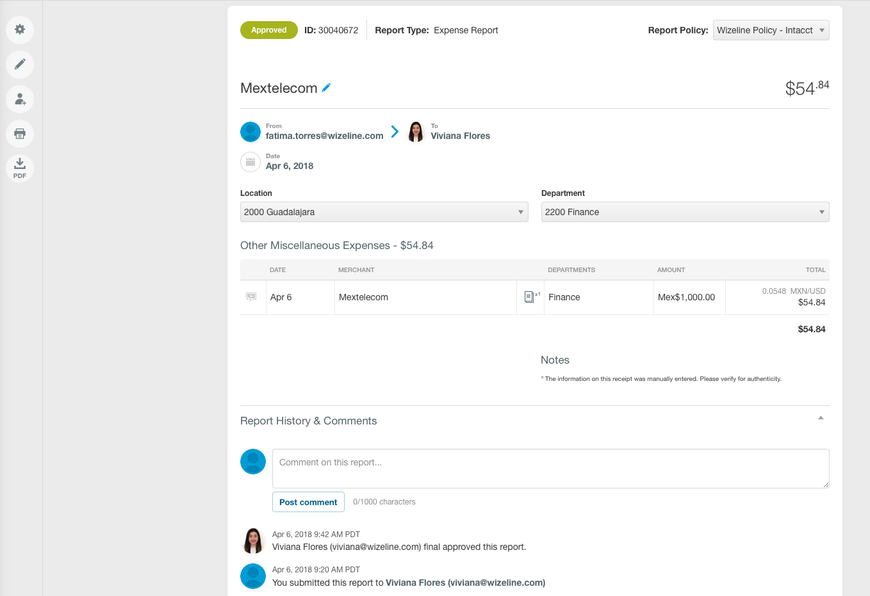
Once your manager approves the report, its status changes to Approved and it moves forward to Finance to schedule the reimbursement.

Slide 26
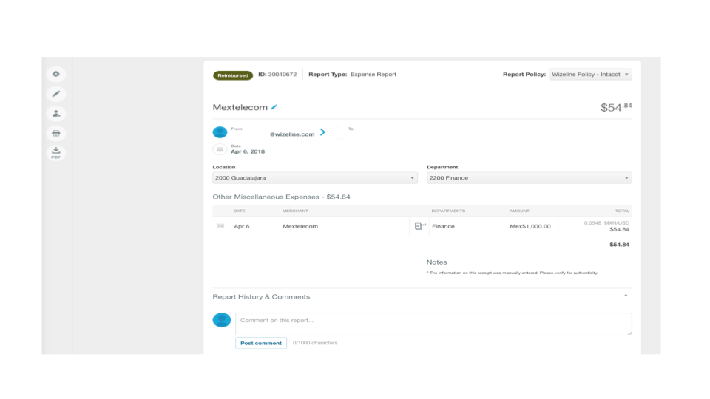
US AND MEXICO
Finance will reimburse you within two weeks after your manager’s final approval, on Thursdays. When the reimbursement is completed, your status report changes to Reimbursed.
US employees: All reimbursements will be wired directly from Expensify to the account you provided.
MX employees: All reimbursements are done manually outside Expensify by wire to your payroll account.
*US reimbursements can take 1-2 days to be reflected in your bank account.

